Slide 1
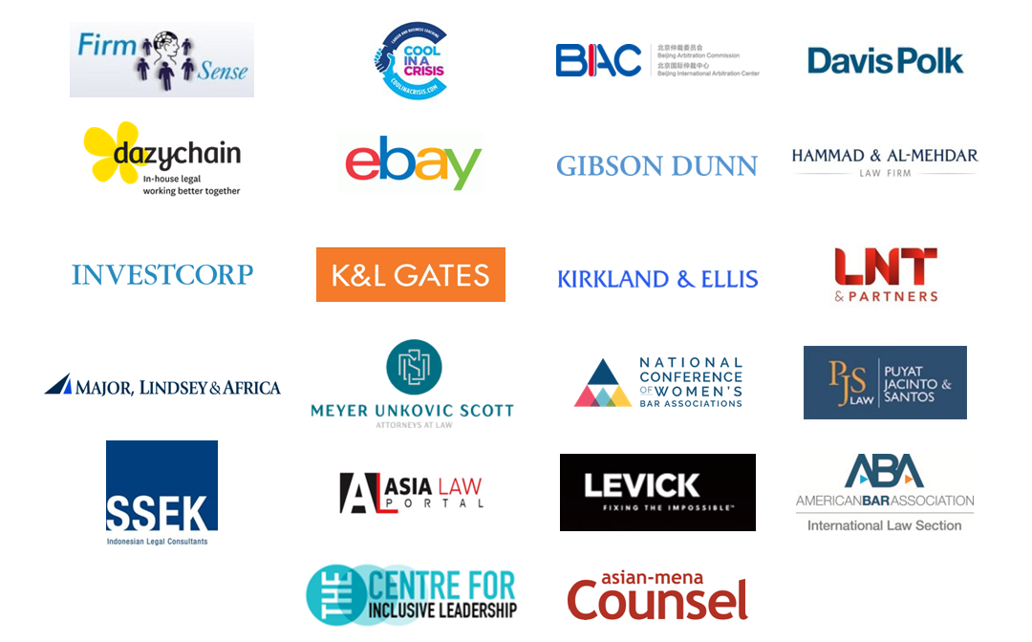
IS COVID-19 TAKING WOMEN LAWYERS’ CAREERS BACK TO THE 1950's?
With thanks to our ‘Women in Law’ Dialogue Supporters*:

Slide 2
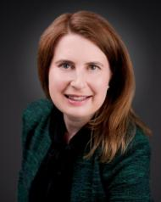
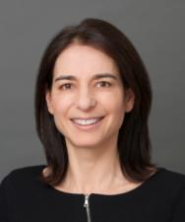
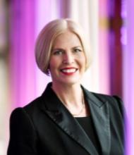
Sally Dyson, consultant and coach to the legal profession at Firm Sense, former Head of Group Compliance & Regulation, Travelex Group and Co-Author of ‘The Real Deal: Law Firm Leadership that Works’
Barbara Becker, Partner and Chair of the firm-wide Diversity Committee, Gibson, Dunn & Crutcher LLP
Christina Blacklaws, Consultant, Blacklaws Consulting Ltd., former President, Law Society of England & Wales

Slide 3
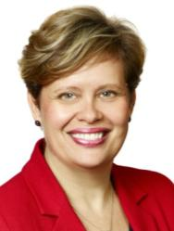
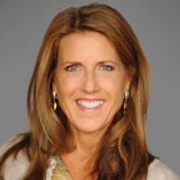
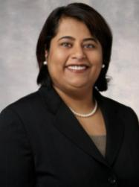
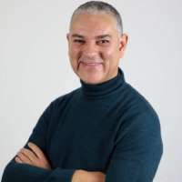
Kate Broer, Partner, Dentons Global Client Development, Toronto, Dentons Canada LLP
Linda Myers, Senior Partner & Founder of Women’s Leadership Initiative, Kirkland & Ellis LLP
Pallavi Mehta Wahi, Co-United States and Seattle Managing Partner, Chair of Firmwide Diversity Committee, K&L Gates LLP
Paul Anderson-Walsh, Co-Founder, The Centre for Inclusive Leadership

Slide 4
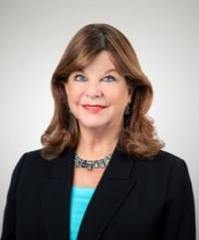
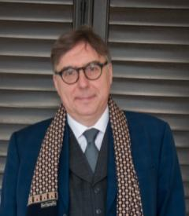
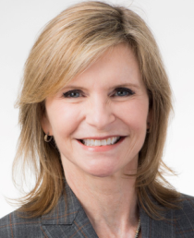
Patricia Lee Refo, President, American Bar Association
Patrick Dransfield, Co-Director, In-House Community
Sonja S. Weissman, Partner, Reed Smith

Slide 5
21,000+ In-House Counsel across

Slide 6
In-House Community Attendees in 2019 Overall Percentage between Male & Female
2, 450 In-House Community attendees in 2019
EMBARGO © 2020 In-House CommunityTM

Slide 7
In-House Community General Counsel in 2019 Overall Percentage between Male & Female
1,101 General Counsel attendees in 2019
EMBARGO © 2020 In-House CommunityTM

Slide 8
Covid-19 and Liminality*
Choices for the future –
a. ‘nationalist routes’
b. forging a better shared future
Social & Economic Impact – rising joblessness & economic impact
Immediate Impact: Fear, Illness, Death
Indirect health results – missed cancer, unintended consequences
*The Liminal Stage is where participants stand at a threshold between their previous way of structuring their identity, time and / or community, and a new way…..

Slide 9
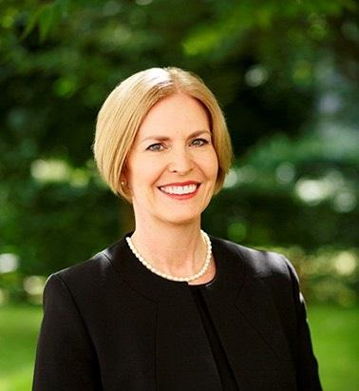
Women in Law
Christina Blacklaws
Immediate Past President of the Law Society of England and Wales
Leader, NED, consultant and speaker
Advisory Board of Thompson Reuters Women in Leadership; Advisory Board of 20-First
@blacklawslaw
christina@blacklawsconsulting.com
07714230852

Slide 10
Disparity at leadership level
Solicitors
Partners

Slide 11
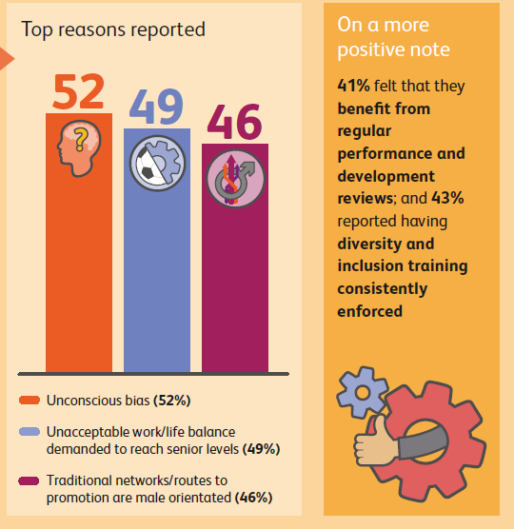

Slide 12
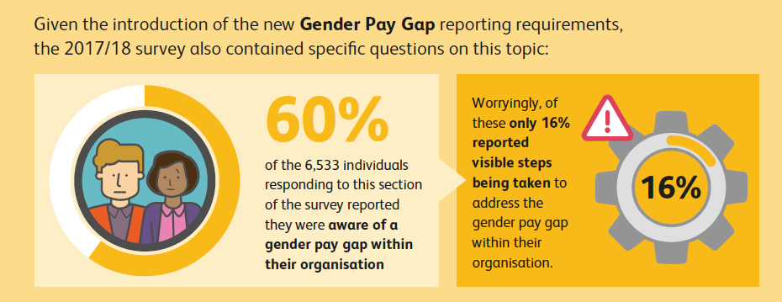

Slide 13
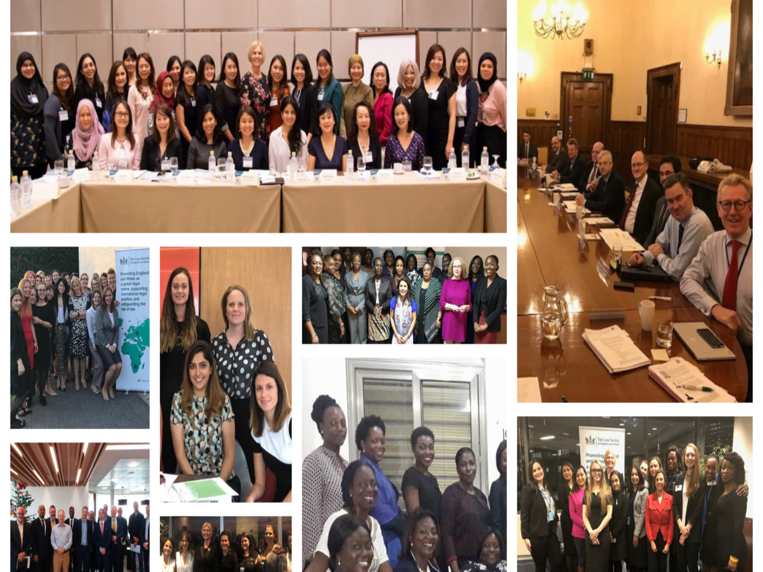

Slide 14
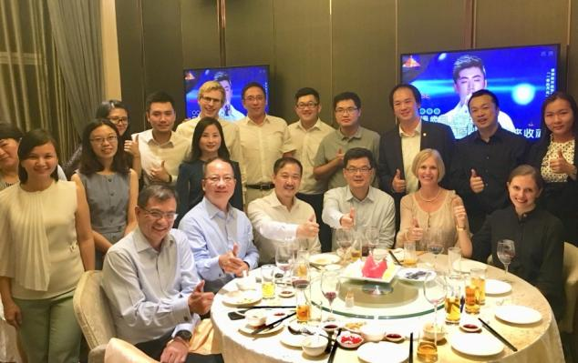
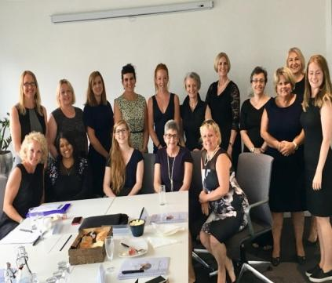
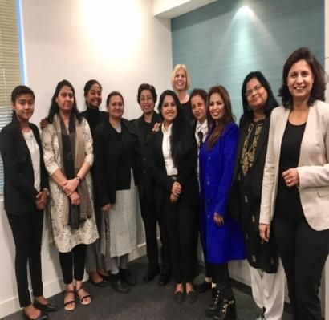
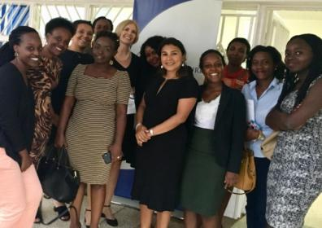
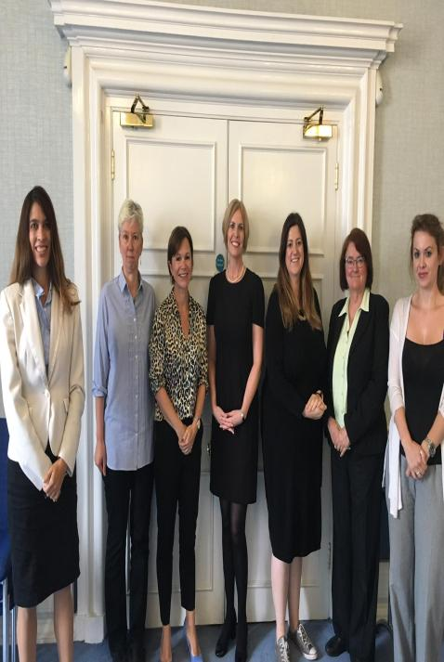
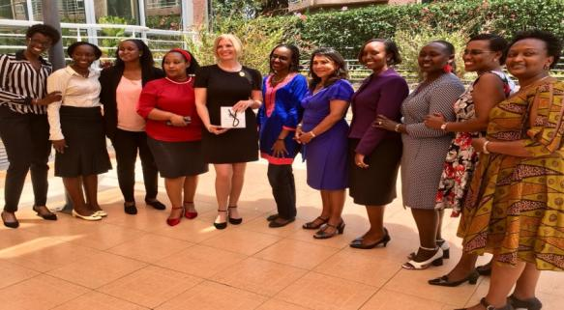
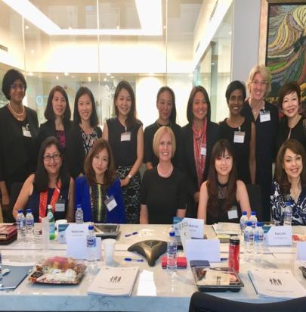
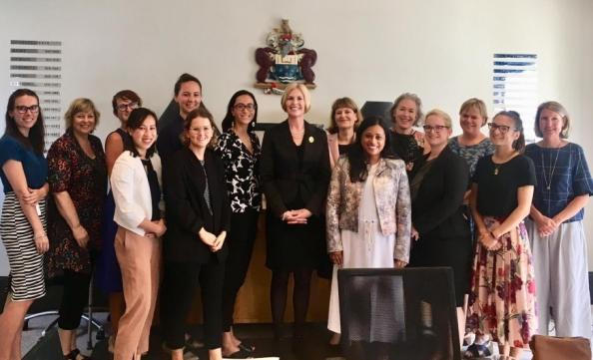

Slide 15
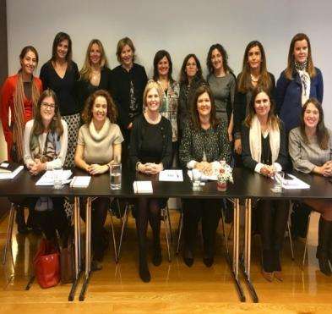
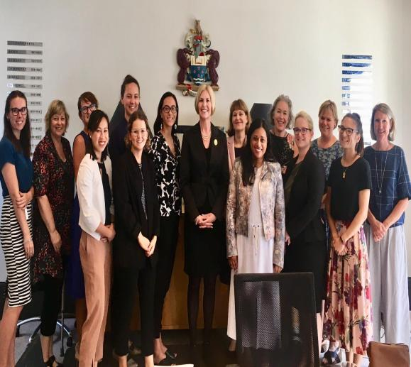
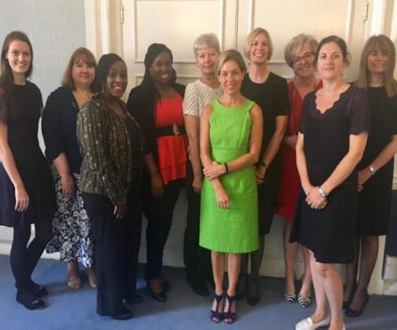
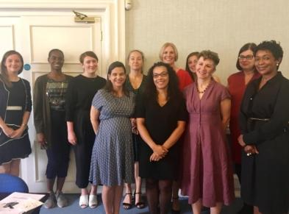
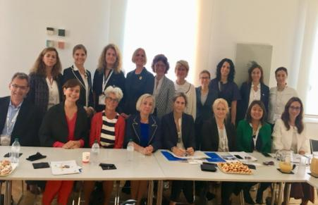
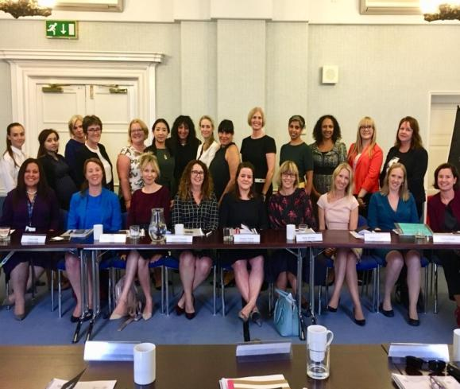
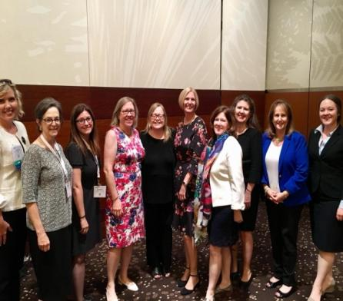

Slide 16
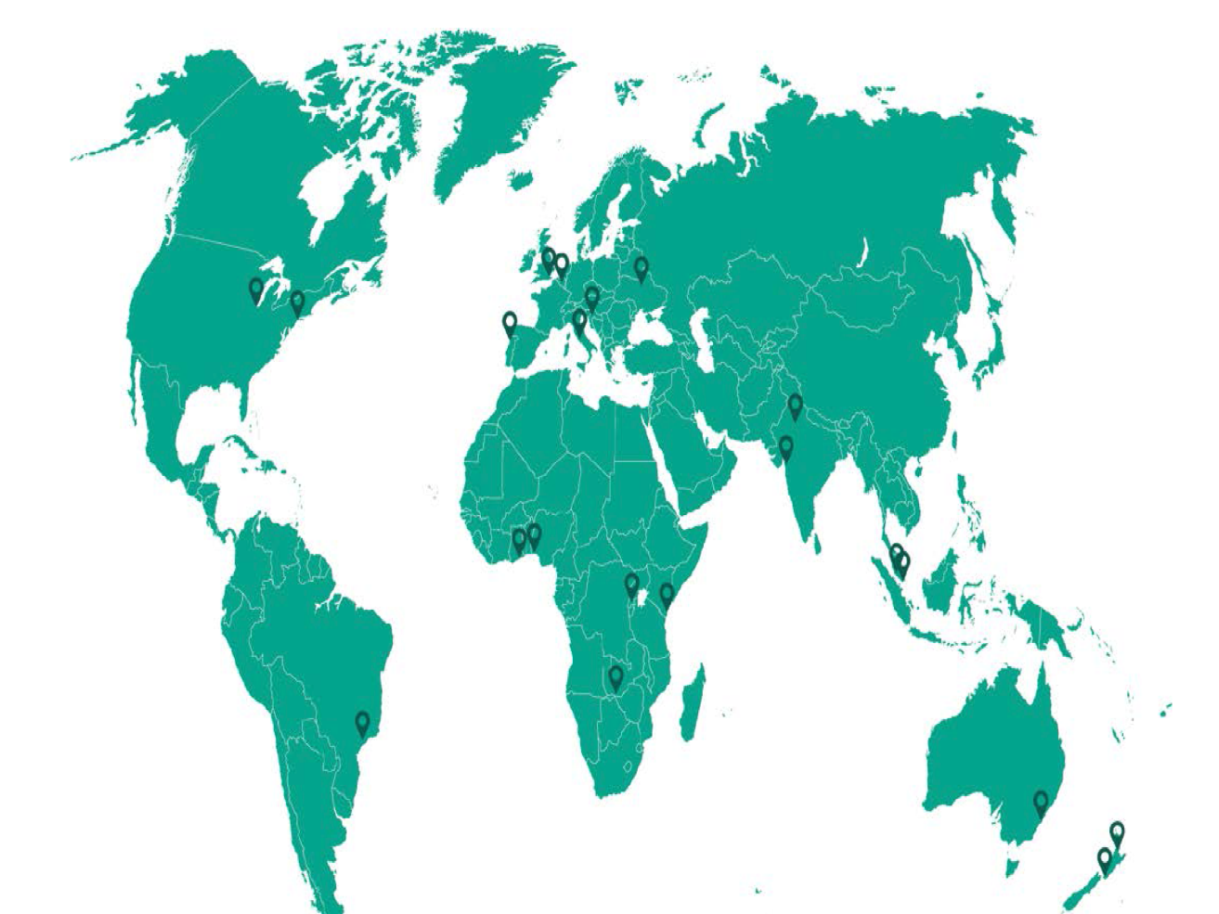
Women in Law roundtables

Slide 17
Toolkits

Slide 18
Research findings

Slide 19
Insights from domestic women’s roundtables
Not fitting into the traditional image of a business leader – which tends to favour characteristics that are traditionally ‘male’.
Significant under representation at leadership levels.
Assumptions impacting development and promotion
Intersectionality affecting women with more than one protected characteristic.

Slide 20
Insights from domestic men’s roundtables
Women are significantly under-represented in senior positions.
This imbalance has led to a larger gender pay gap, mainly but not exclusively, due to the small percentage of women in senior leadership roles
There needs to be a focus on female promotion and success planning.
Equal opportunities are needed to ensure women are involved in high profile work ,to gain suitable experience and credibility needed for promotion.

Slide 21
Insights from international roundtables
The challenges and experiences of female lawyers are very similar across the globe.
Shared experiences in relation to traditional gender roles and stereotypes, gender pay disparity and the lack of flexible working.
Particularly, working mothers seem to be penalised for their additional care giving commitments outside of work.
Lack of transparency about financial compensation across all regions. This prevents the identification of pay discrepancies and accountability.

Slide 22
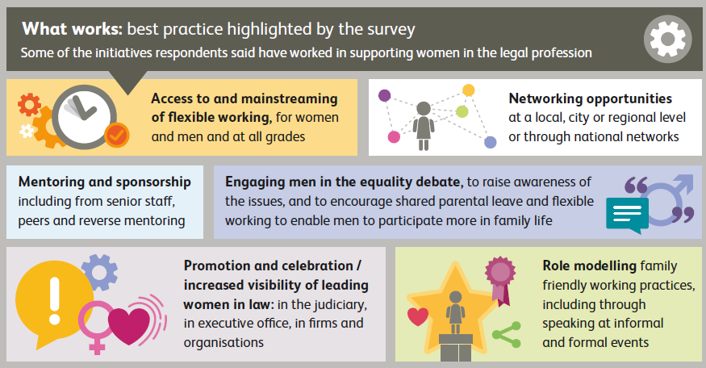
Solutions highlighted in our survey

Slide 23
Solutions
Supportive and engaged leadership
Prioritising diversity in business planning
Greater transparency
Consistent training to eliminate bias
Assess recruitment and selection policies
Gender champions, bystander training and balanced decision making boards
Make flexible working available to all

Slide 24
Blueprint for Gender Balance

Slide 25
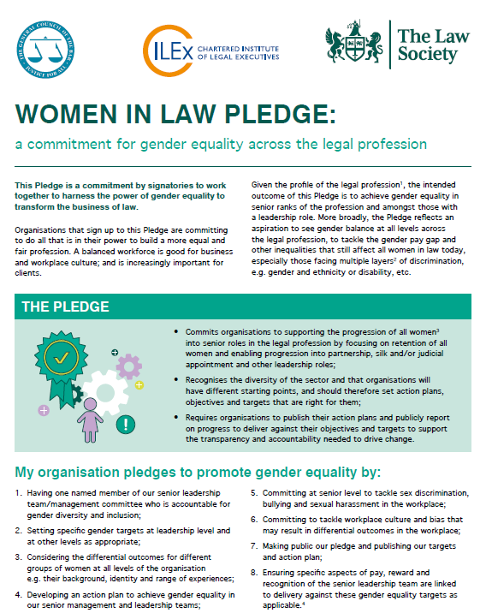
Women in Law Pledge & Guidance

Slide 26
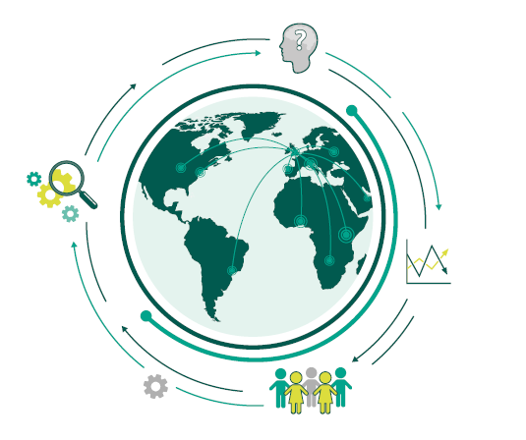

Slide 27
Thank you! Any questions?
Christina Blacklaws
Immediate Past President of the Law Society of England and Wales
Leader, NED, consultant and speaker
Advisory Board of Thompson Reuters Women in Leadership; Advisory Board of 20-First
@blacklawslaw
christina@blacklawsconsulting.com
07714230852

Slide 28
Patrick Dransfield, Co-Director, In-House Community
Patrick is Co-Director of the In-House Community, wholly owned by Pacific Business Press and has twenty-two years of experience working in the legal industry: as Asia Managing Director of Euromoney Institutional Investor, and then as Marketing and Business Development Director for Asia for Shearman & Sterling and White & Case respectively. Patrick joined Pacific Business Press in 2008. His publishing career began with Haymarket Publishing in 1987. Patrick is a graduate of Leeds University and also holds a Master’s Degree in Far East Area Studies from the School of Oriental & African Studies (London University SOAS). Patrick is included in the 30 people to watch in the business of law in Asia 2019 by Asia Law Portal.

Slide 29
Sally Dyson, consultant and coach to the legal profession at Firm Sense, former Head of Group Compliance & Regulation at Travelex Group and Co-Author of “The Real Deal: Law Firm Leadership that Works.”

Slide 30
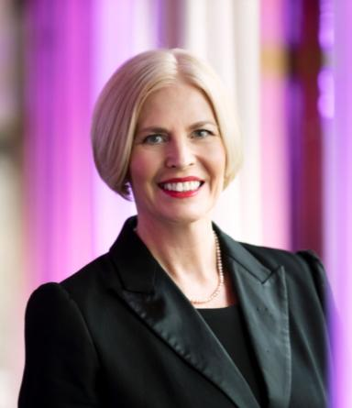
Christina Blacklaws, Consultant, Blacklaws Consulting Ltd., former President, Law Society of England & Wales
Christina is the immediate past president of the Law Society of England and Wales, chairs two U.K. government panels in LawTech and advises global business as a strategic consultant and NED. She is an expert in diversity and inclusion.

Slide 31
Barbara L. Becker, Partner and Chair of the firm-wide Diversity Committee, Gibson, Dunn & Crutcher LLP
Barbara L. Becker is a corporate partner in the New York office of Gibson, Dunn & Crutcher and Co-Chair of the firm-wide Mergers and Acquisitions Practice Group. She is a member of the firm-wide Executive Committee, Chair of the firm-wide Diversity Committee and Chair of the New York City Bar’s M&A Committee. Barbara is a mother of four children.

Slide 32
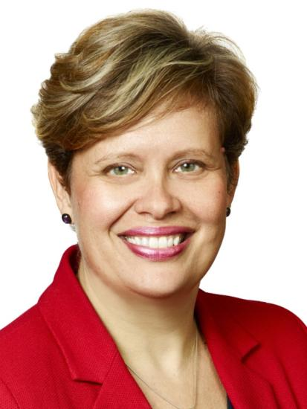
Kate Broer, Partner, Dentons Global Client Development, Toronto, Dentons Canada LLP
Working in Dentons’ Global Clients and Markets team, Kate’s role focuses on the role of diverse and inclusive teams and perspectives play in the client experience with a focus on enhancing, supporting and supplementing women’s leadership and participation in client relationships.
Her inclusion and diversity leadership has been recognized with a Catalyst Canada Honours Award, a Leaders to Be Proud of Leading Executive Ally Award and of a Queen’s Diamond Jubilee Medal.

Slide 33
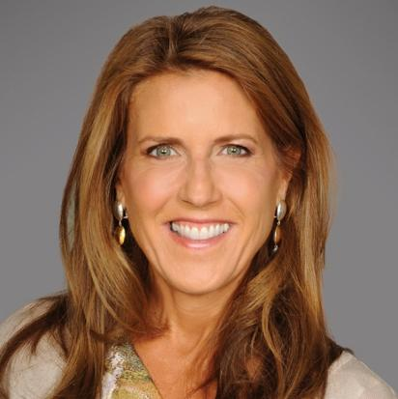
Linda Myers, Senior Partner & founder of Women’s Leadership Initiative, Kirkland & Ellis
Linda Myers is senior partner and one of the original members of the Kirkland & Ellis’ Debt Finance Practice Group. Linda also served on the Firm’s global management committee for ten years and is a founding member of Kirkland’s Women’s Leadership Initiative.

Slide 34
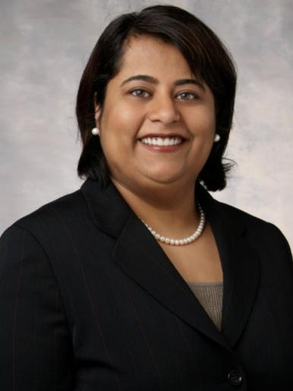
Pallavi Mehta Wahi, Co-United States and Seattle Managing Partner, Chair of Firmwide Diversity Committee, K&L Gates LLP
Pallavi Mehta Wahi is co-managing partner (U.S.) of the global law firm of K&L Gates and serves as Chair of the firmwide Diversity Committee. Her practice focuses on corporate and IP litigation.

Slide 35
Paul Anderson-Walsh, Co-Founder, The Centre for Inclusive Leadership

Slide 36
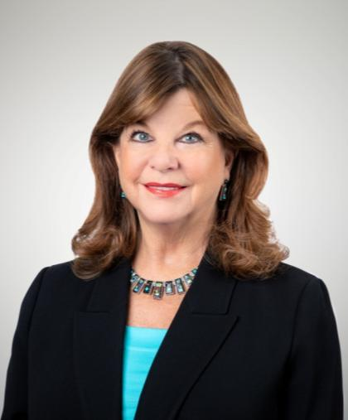
Patricia Lee Refo, President, American Bar Association
Patricia Lee “Trish” Refo is president of the American Bar Association, the largest voluntary association of attorneys and legal professionals in the world.

Slide 37
Sonja S. Weissman, Partner, Reed Smith

